Slide 1
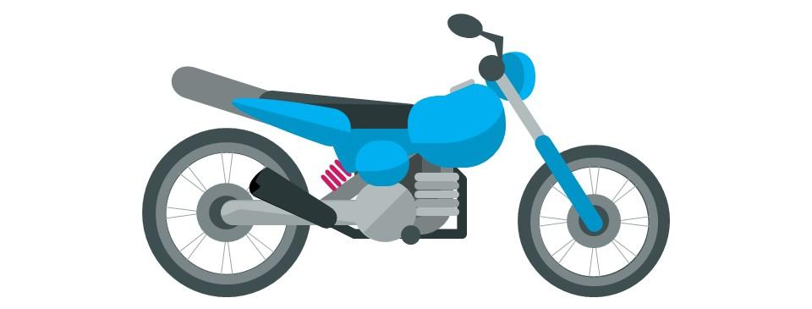
CAPSTONE PROJECT-2
Seoul Bike Sharing Demand Prediction
by
SATYAM JYOTI SANKAR

Slide 2
CONTENT
BUSINESS UNDERSTANDING
DATA SUMMARY
DATA DESCRIPTION
PREPROCESS DATA
EXPLORATORY DATA ANALYSIS
CORRELATION MATRIX
IMPLEMENTING ALGORITHMS
CHALLENGES
CONCLUSIONS

Slide 3
BUSINESS UNDERSTANDING
Currently Rental bikes are introduced in many urban cities for the enhancement of mobility comfort.
It is important to make the rental bike available and accessible to the public at the right time as it lessens the waiting time.
Eventually, providing the city with a stable supply of rental bikes becomes a major concern. The crucial part is the prediction of bike count required at each hour for the stable supply of rental bikes.
The main goal of project is to maximize the availability of bikes to the customer and minimize the time of waiting to get a bike on rent.

Slide 4
DATA SUMMARY
The dataset contains weather information (Temperature, Humidity, Windspeed, Visibility, Dewpoint, Solar radiation, Snowfall, Rainfall), the number of bikes rented per hour and date information.
This dataset contains the hourly and daily count of rental bikes between years 2017 and 2018 in Capital bike share system with the corresponding weather and seasonal information.
The dataset contains 8760 rows (every hour of each day for 2017 and 2018) and 14 columns (the features which are under consideration).
One Datetime features ‘Date’.
Three categorical features ‘Seasons’, ‘Holiday’, & ‘Functioning Day’.

Slide 5
DATA DESCRIPTION
Dependent variable:
Rented Bike count - Count of bikes rented at each hour
Independent variables:
Solar radiation - MJ/m2
Rainfall - mm
Snowfall - cm
Seasons - Winter, Spring, Summer, Autumn
Holiday - Holiday/No holiday
Functional Day - NoFunc(Non Functional Hours), Fun(Functional hours)
Date : year-month-day
Hour - Hour of he day
Temperature-Temperature in Celsius
Humidity - %
Windspeed - m/s
Visibility - 10 m
Dew point temperature - Celsius

Slide 6
PREPROCESS DATA
Records=8760 and Features=14
No data is Missing in given dataset.
There are No Duplicate values present
There are No null values.
And ﬁnally we have 'rented bike count' variable which we need to predict for new observations.
We change the name of some features for our convenience , they are as below 'Rented_Bike_Count', 'Hour', 'Temperature', 'Humidity', 'Wind_speed', 'Visibility', ‘Dew_point_temperature', 'Solar_Radiation', 'Rainfall', 'Snowfall', 'Seasons', 'Holiday', 'Functioning_Day', 'month','weekdays_weekend'

Slide 7
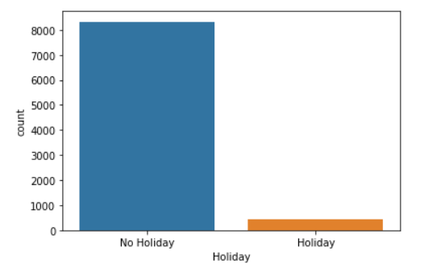
EDA(contd...)
Comparison between Book on Holiday and normal day
Here we see that the booking of bike in Holiday is very less compare to the normal day.

Slide 8
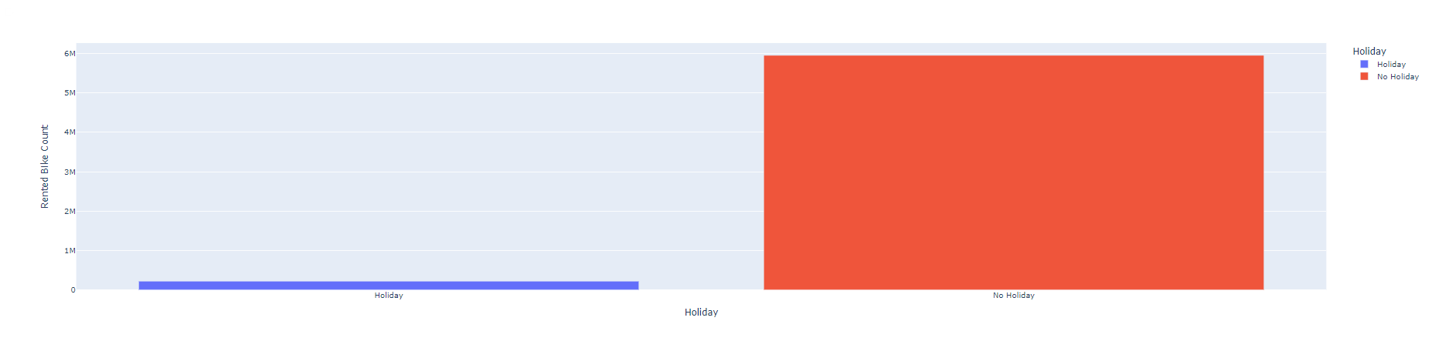
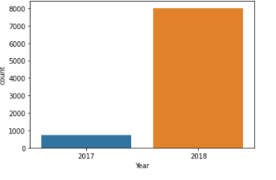
EDA(contd...)
Count no of rented bike as for holiday and normal day.
Here , we see that in compare to 2017,2018 rental bike usages is so high in 2018 , that means the increases the rental bike count per year.
Rental bike count is very high in normal day compare to holiday.

Slide 9
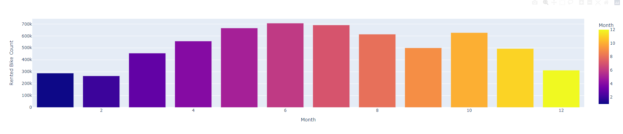
EDA(contd...)
Count no of rented bike monthly wise.
Here , We see that the count no of rented bike is very high in month of june and very low in February.

Slide 10
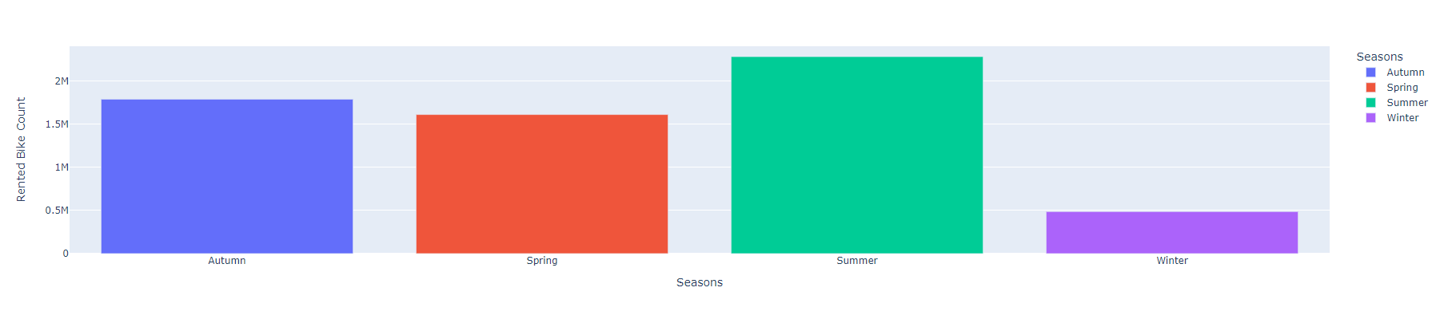
EDA(contd...)
How many total rental of bike as for each seasons.
Here , we see in summer seasons the rented bike count is very high near about 2M and winter is very low .

Slide 11
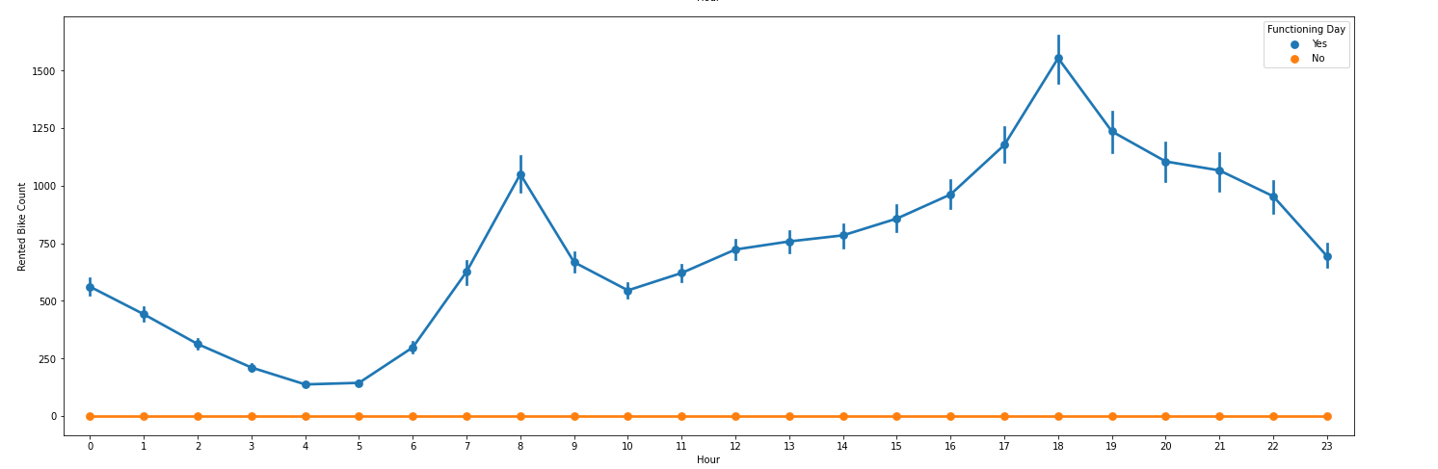
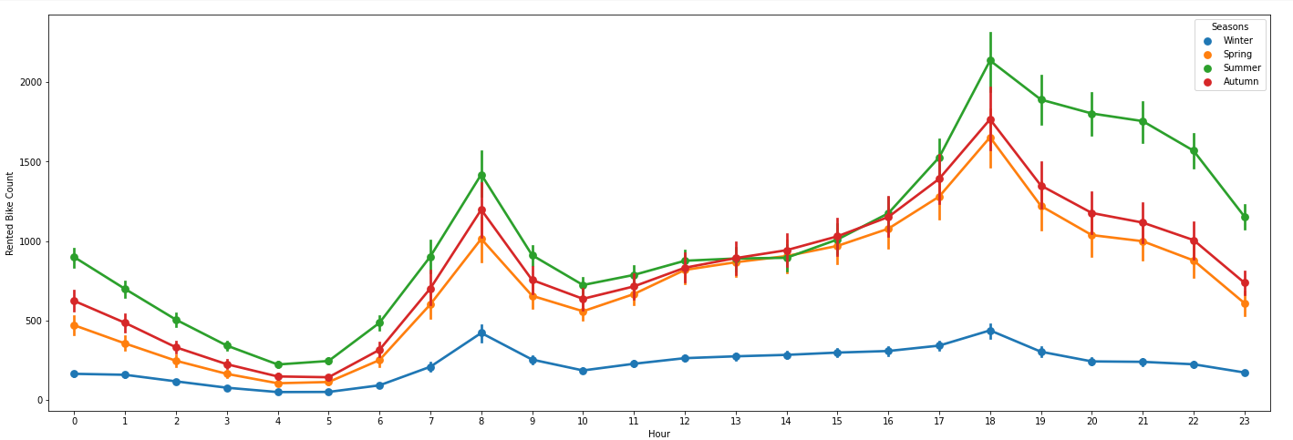
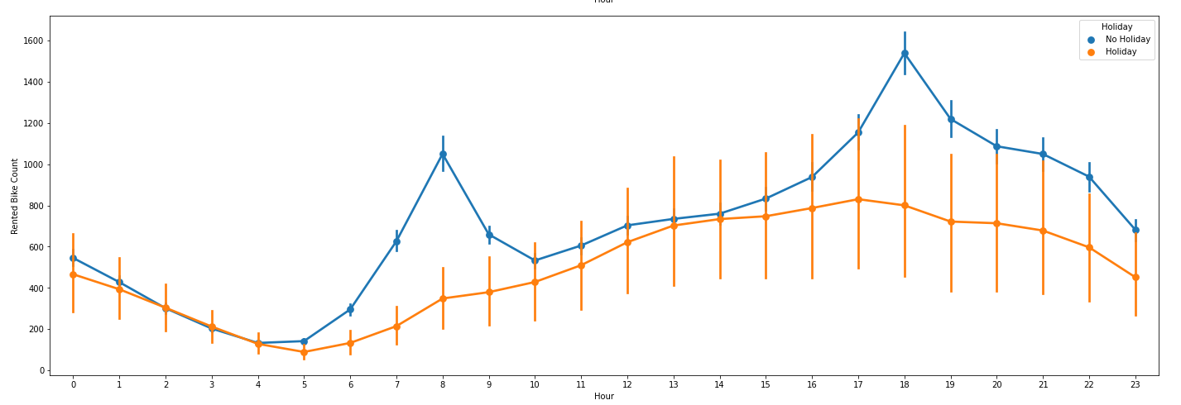
EDA(contd...)
Book bike for no of hour as for seasons,Holiday and functioning day

Slide 12
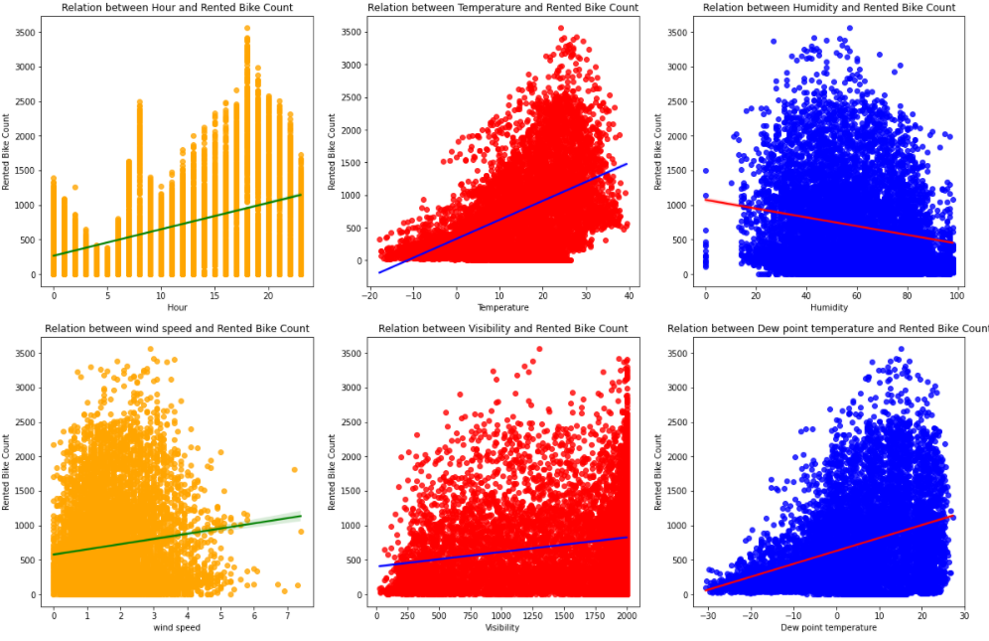
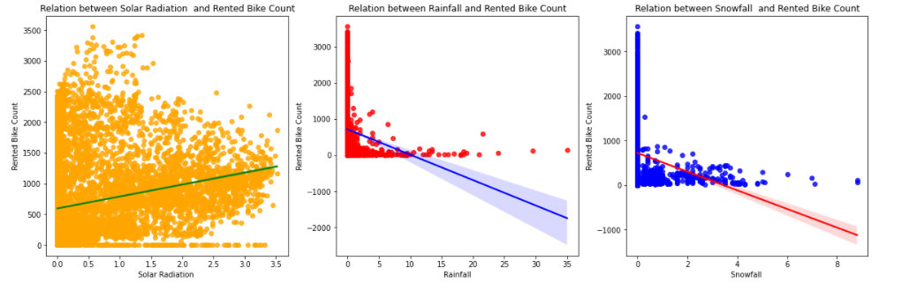
Regplot show correlation between our bike rent with all other factor.

Slide 13
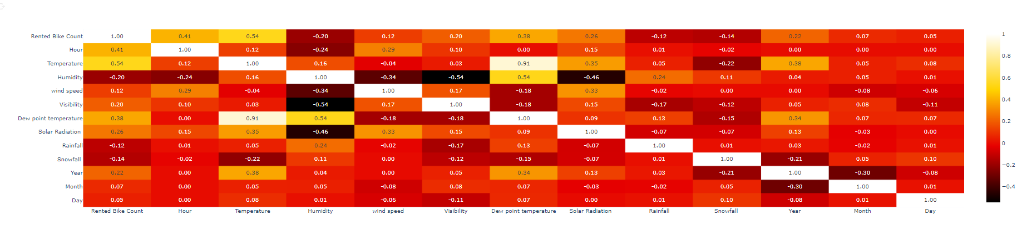
CORELATION MATRIX
From the above correlation graph
We see that there are highly multi collinearity between temperature and dew point temperature(0.91) so we can add make them a single temp column in 2nd we see that the day and month are very less collinearity with rented bike (0.07) ..so we drop it.

Slide 14
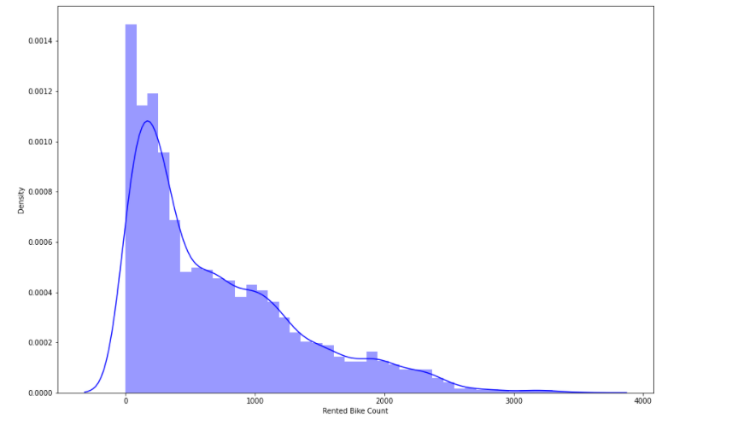
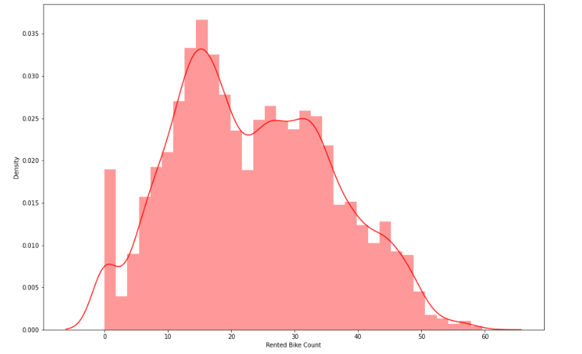
Distribution of Numerical Features
Here our dependent variable Rented Bike Count is highly Positively skewed

Slide 15
MODEL BUILDING
LINEAR REGRESSION
LASSO REGRESSION
RIDGE REGRESSION
DECISION TREES REGRESSOR
RANDOM FOREST REGRESSOR
GRADIENT BOOSTED REGRESSOR
GRADIENT BOOSTING REGRESSOR WITH GRIDSEARCHCV

Slide 16
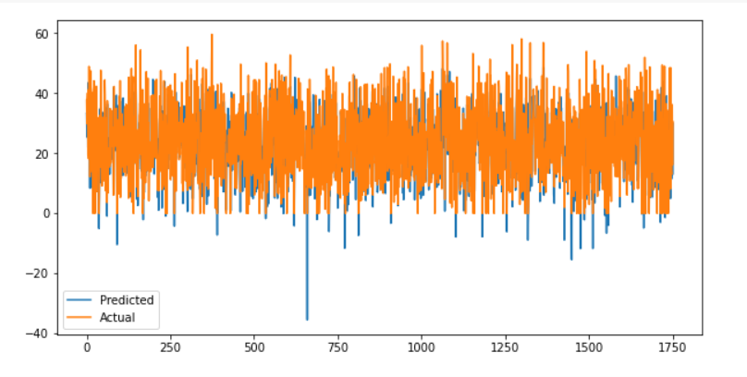


Linear Regression
Train Set Metrics
Test Set Metrics

Slide 17
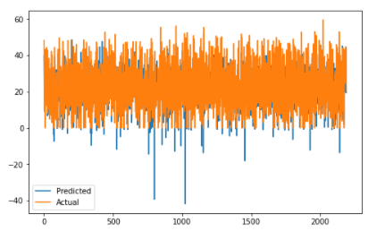


Lasso Regression
Train Set Metrics
Test Set Metrics

Slide 18
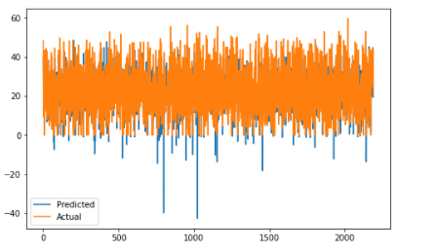


Ridge Regression
Train Set Metrics
Test Set Metrics

Slide 19
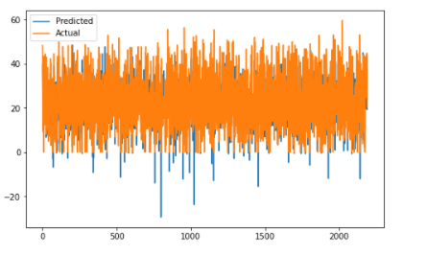


ElasticNet Regression
Train Set Metrics
Test Set Metrics

Slide 20
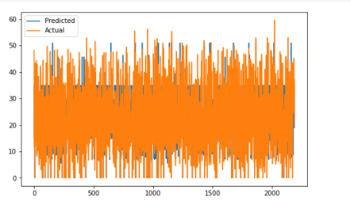


Decision Tree
Train Set Metrics
Test Set Metrics

Slide 21
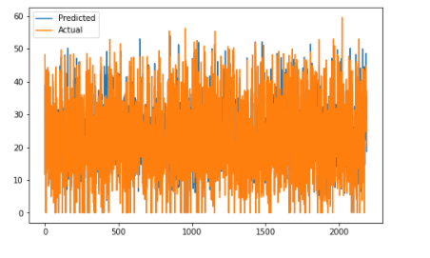
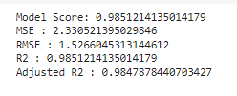

Random Forrest
Train Set Metrics
Test Set Metrics

Slide 22
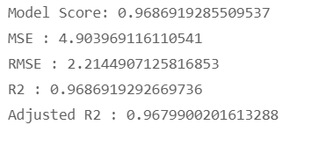
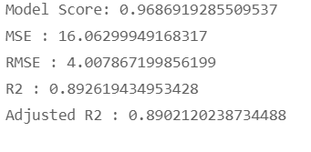
Gradient Boosting
Train Set Metrics
Test Set Metrics

Slide 23
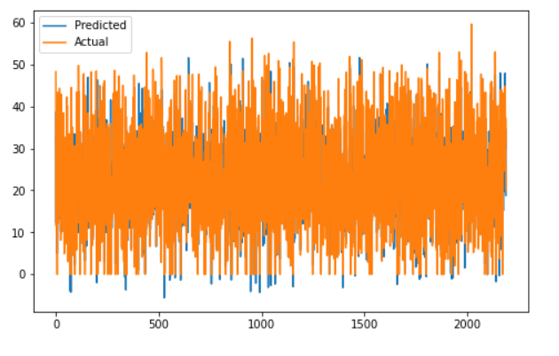
XGBOOST REGRESSION
Train Set Metrics
Test Set Metrics

Slide 24
CHALLENGES
As dataset was quite big enough which led more computation time.
Feature engineering
Feature selection
Optimising the model
Carefully tuned Hyperparameters as it affects the R2 score.

Slide 25
CONCLUSION
Bike rental count is mostly correlated with the time of the day as it is peak at 10 am morning and 8 pm at evening.
‘Hour’ of the day holds the most important feature.
We observed that bike rental count is high during working days than non working day.
The Rented bike Count has been increased from 2017-2018. No Overfitting is seen.
When we compare the root mean squared error and mean absolute error of all the models, Random_forest and Gradient Boosting gives the highest R2 score ending with the accuracy of 89% . So, finally this two model are best for predicting the bike rental count on daily basis.

Slide 26
THANK YOU

